Slide 1
Tuesday, August 21, 2012
TISK Problems
Simplify: $\frac{15}{\sqrt{3}}$
Evaluate: $\frac{3}{5}÷\frac{4}{9}$
Simplify: $3\sqrt{90}+6\sqrt{10}−2\sqrt{81}$
We will have 3 Mental Math Questions today.
Homework: p. 81 #20-40 evens
Notes:
Mental Math:
Start with the number of days in a week. Multiply by the number of eggs in a dozen. Divide by the number of quarters in a dollar. Triple your answer. (63)
Start with the number of feet in a yard. Multiply by the number of meters in a kilometer. Find half of that number. Divide by half the number of years in a decade. (300)
Start with the number of inches in a foot. Add the largest prime number less than 50. Subtract thirteen. Find half. (23)

Slide 2
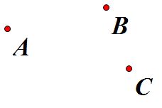
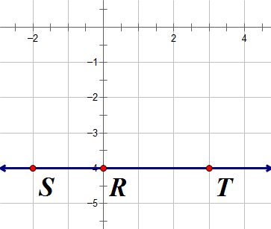
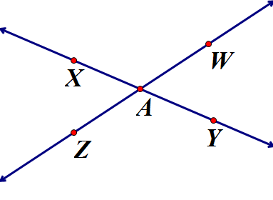
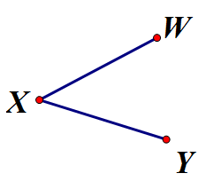
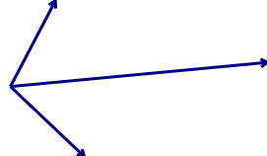
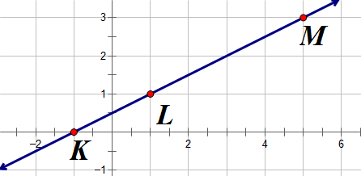
Homework Check
15)
15) Sample answer: Points A, B, and C do not lie on a line.
16) AB = EF
17) Sample answer: X, Y, Z, and W are noncollinear.
18) Sample answer: $∡1$ and $∡2$ have a common side and a common vertex.
19) Sample Answer: Points R, S, and T are collinear.
20) x > 5
23) False. Counterexample:
24) true; in any rectangle, the opposite sides have to have the same measures.
25) false. Counterexample:
26) false; counterexample: If x = -2 then –x = -(-2) = 2.
19)
17)
23)
18)
1
2
25)

Slide 3
§2.2 Conditional Statements
Conditional Statement: A conditional statement has two parts, a hypothesis and a conclusion. If-Then Form: the “if” part is the hypothesis; the “then” part is the conclusion.
If it is noon in Georgia,
then it is 9 A.M. in California.
hypothesis
conclusion
Conditional statements can be either true or false.
To show that a conditional statement is true, you must prove that for EVERY POSSIBLE case that satisfies the hypothesis, the conclusion is valid.
To prove that a conditional statement is false, a single counterexample where the hypothesis is true but the conclusion is invalid is enough proof.

Slide 4
Write each of the statements in if-then form.
All ducks are soft.
The city you visited, Phoenix, is the capital of Arizona.
On Tuesdays, Ms. McEwen assigns Science homework.

Slide 5
Proving Statements Wrong
Write a counterexample to show that the following conditional statement is false.
If x ² = 16, then x = 4.
SOLUTION
Think of a case where x ² = 16
There are 2: x = – 4 and x = 4.
However, when x = – 4, the conclusion is false (if x = – 4 then it can’t = 4).
This means the given conditional statement is false.

Slide 6
Notation
We will sometimes use the letters p and q to stand for hypothesis and conclusion.
When this is done, the statement can be simplified to: If $p⇒q$
This notation helps us to show other types of statements.

Slide 7
Converse
A converse is what you get when you flip the hypothesis and conclusion of a statement.
Statement: If $p⇒q$
Converse: If $q⇒p$
Example: If it is Saturday, then Miss W plays video games.
Converse: If Miss W plays video games, then it is Saturday.

Slide 8
Inverse
An inverse is obtained by negating the hypothesis and the conclusion of the statement.
Conditional Statement: If $p⇒q$
Inverse: If$\sim p⇒\sim q$
Example: If it is Saturday, then Miss W plays video games.
Inverse: If it is not Saturday, then Miss W does not play video games.

Slide 9
Contrapositive
A contrapositive is obtained by negating the hypothesis and the conclusion of the converse.
Conditional Statement: If $p⇒q$
Contrapositive: If $\sim q⇒\sim p$
Example: If it is Saturday, then Miss W plays video games.
Contrapositive: If Miss W does not play video games, then it is not Saturday.

Slide 10
Truth of Statements
When verifying true conditional statements, there are some links!
If the original statement is true, its contrapositive will also be true.
If the converse of a statement is true, its inverse will also be true.

Slide 11
Try it out…
For each statement, do the following:
Rewrite as a conditional statement.
Determine if it is true.
Determine which of the other statements (inverse, converse, contrapositive) are also true.
Statement 1: All CPA 9th Grade students wear black socks.
Statement 2: A student who earns 95% has an A.
Statement 3: All lines contain at least two rays.
Statement 4: For every integer value of x less than 4, x is an integer.
Notes:
Statement 1:
If a student is a CPA 9th Grade student then the student wears black socks.
False. The student could wear another color sock and still be a CPA 9th Grade student.
Inverse: If a student is not a CPA 9th Grade student then the student does not wear black socks. (False) Converse: If a student wears black socks then the student is a CPA 9th Grade student. (False) Contrapositive: If a student does not wear black socks then the student is not a CPA 9th Grade student. (False)
Statement 2:
If a student earns a 95% then the student has an A.
True.
Inverse: If a student does not earn 95% then the student does not have an A. (False) Converse: If a student has an A then the student earns 95%. (False) Contrapositive: If a student does not have an A then the student does not earn 95%. (True)
Statement 3:
If it is a line then it contains at least two rays.
True.
Inverse: If it is not a line then it does not contain at least two rays. (False) Converse: If it contains at least two rays then it is a line. (False) Contrapositive: If it does not contain at least two rays then it is not a line. (True)
Statement 4:
If x is an integer less than 4, then x is an integer.
True
Inverse: If x is not an integer less than 4, then x is not an integer. (False) Converse: If x is an integer, then x is an integer less than 4. (False) Contrapositive: If x is not an integer, then x is not an integer less than 4. (True)

Slide 12
Homework
p. 81 #20-40 evens
Yes, there is a lot of writing on this assignment.
If you would prefer to type it, you may do so.

